Slide 1
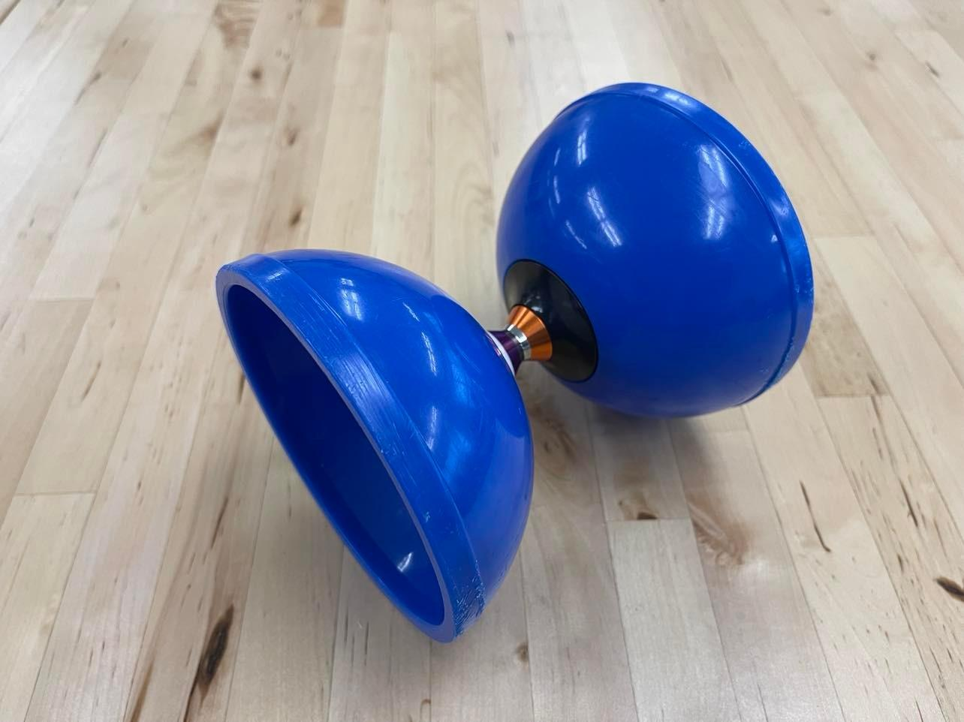
Motion Capture Analysis of Diabolo Juggling
Jeb Cui (Computer Systems Lab ’22)

Slide 2
BACKGROUND
01
METHODS
02
RESULTS
03
CS world of diabolos
Vicon, Models, and Flask
Comparing the models

Slide 3
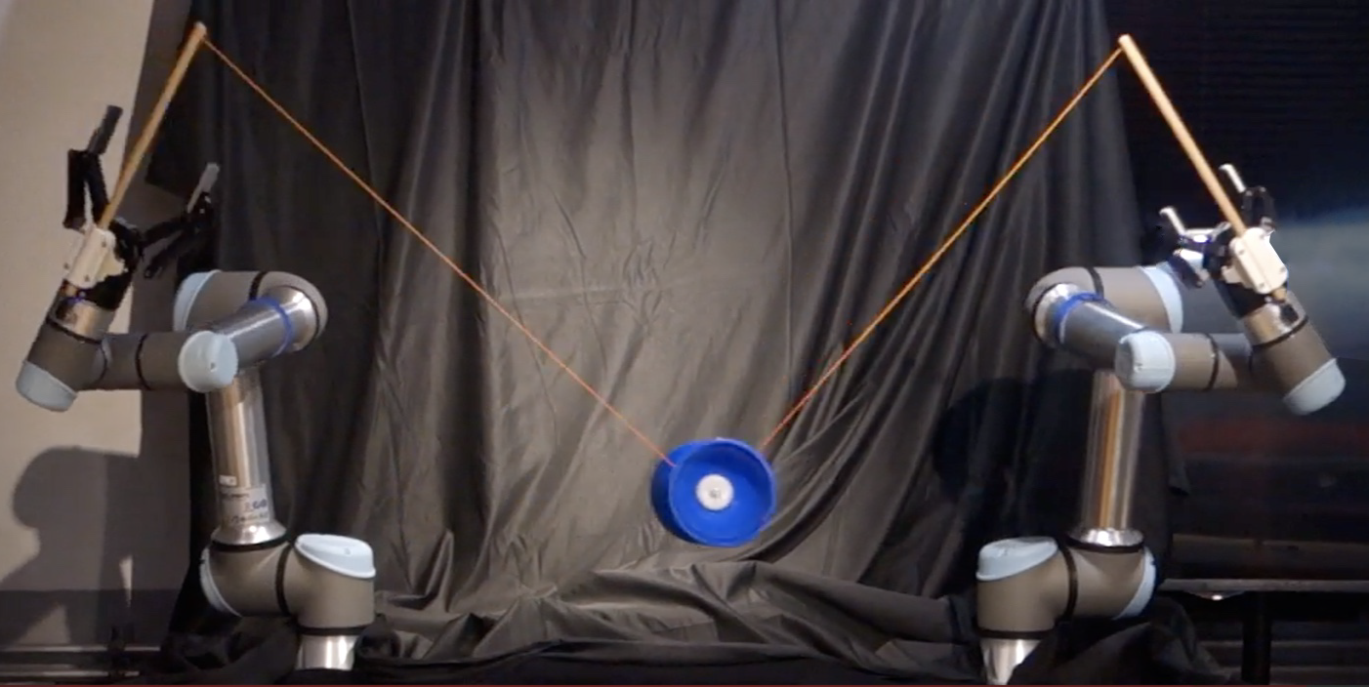
Background: CS world of Diabolos
01
von Drigalski et al.
A diabolo predictor that estimates the next state based on the current state and the stick positions. Using the forward Euler method with constraints.

Slide 4
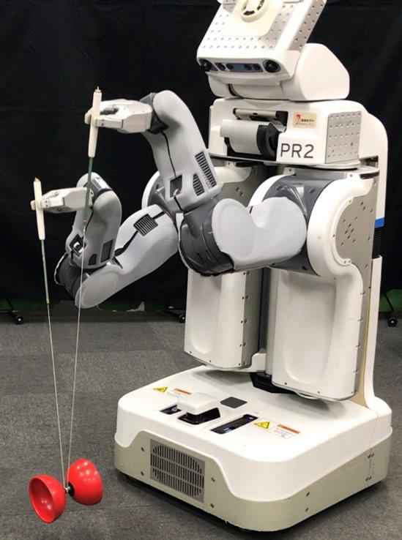
Background: CS world of Diabolos
01
Murooka et al.
Diabolo-Manipulation-Net trained using the diabolo’s pitch and yaw, and the robot’s arm height difference and robot’s spin speed.

Slide 5
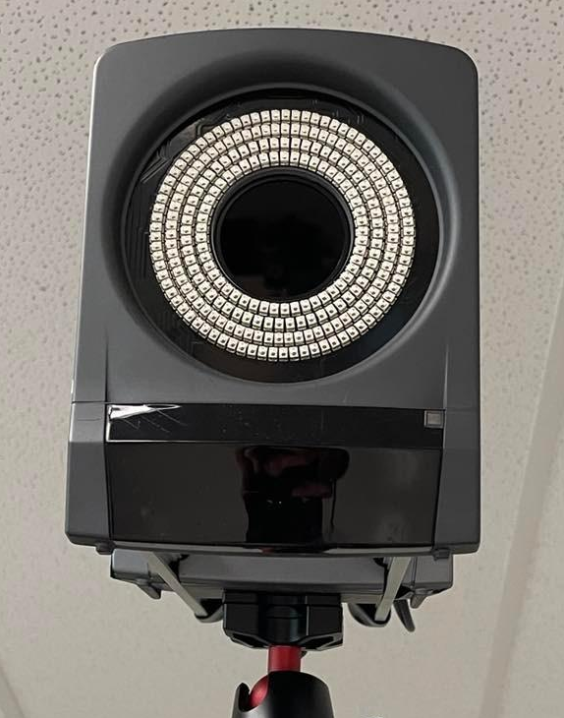
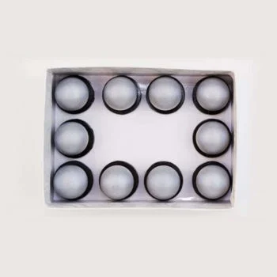
02
Vicon Motion Capture System
9 Cameras (MX T20’s and MX T40’s) and retroreflective marker
Notes:
Refer to physical vicon motion capture system

Slide 6
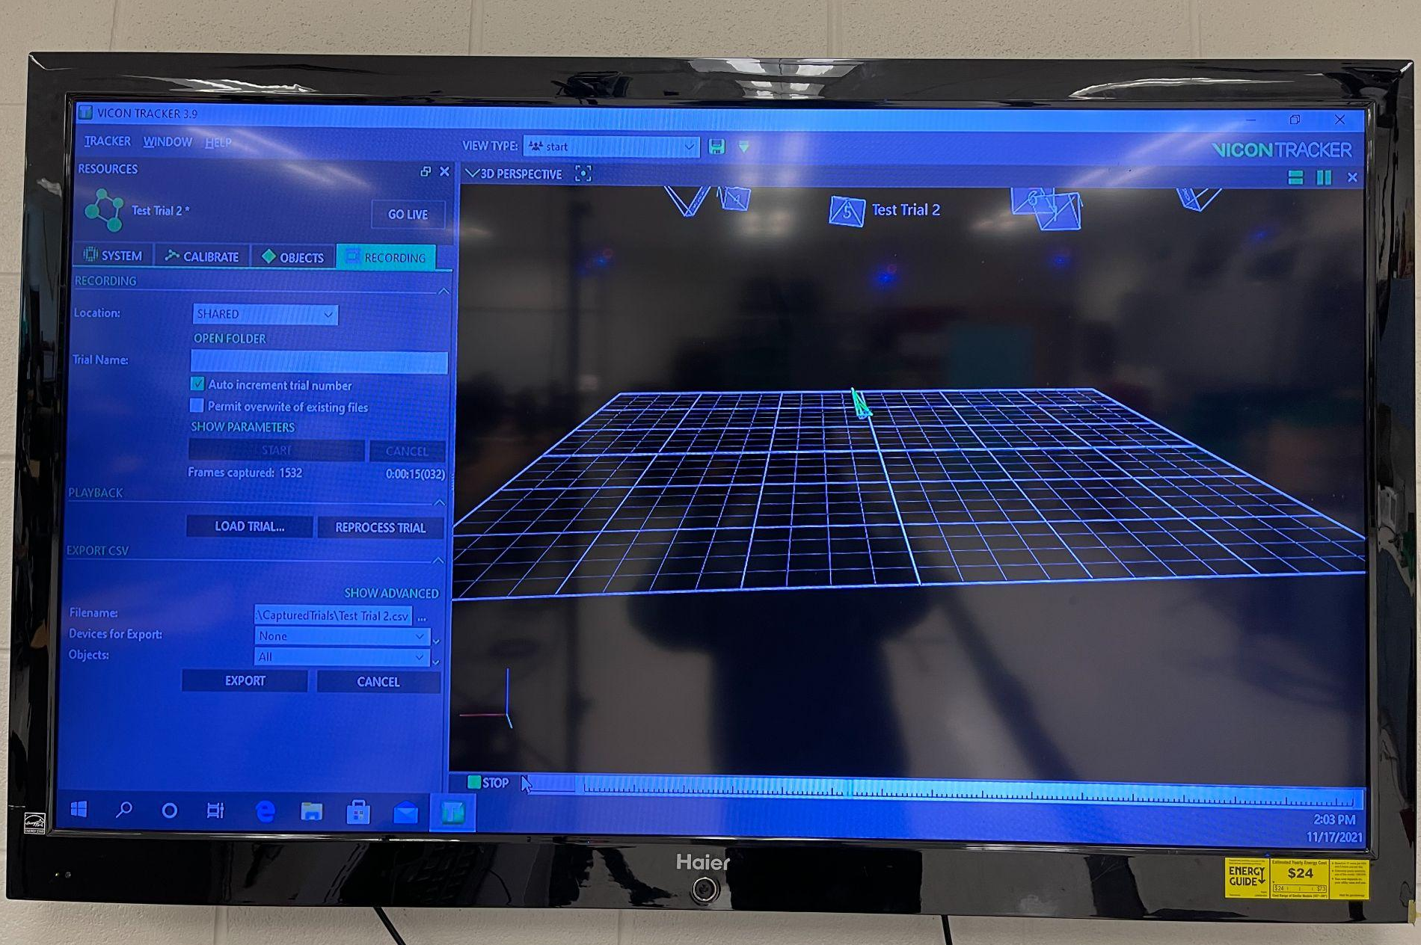
02
Vicon Motion Capture System
Vicon Tracker Software for diabolo performance recordings
Notes:
Show video/demo

Slide 7
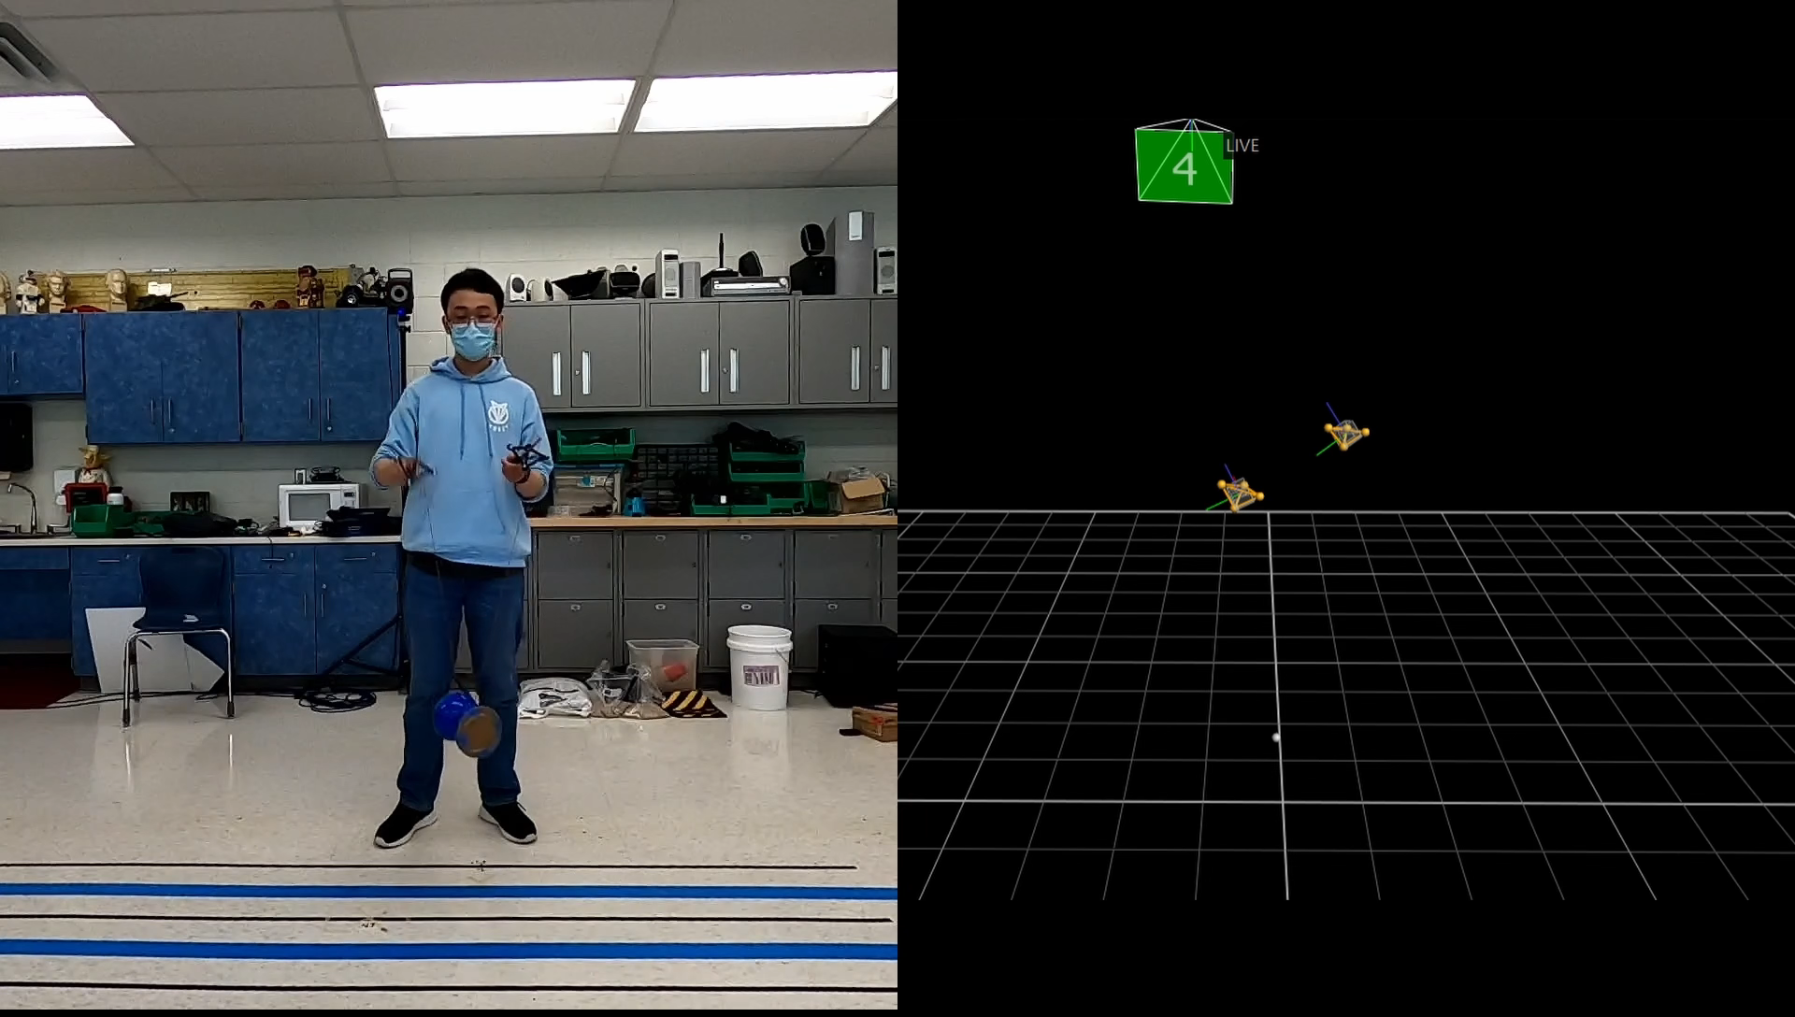

Slide 8
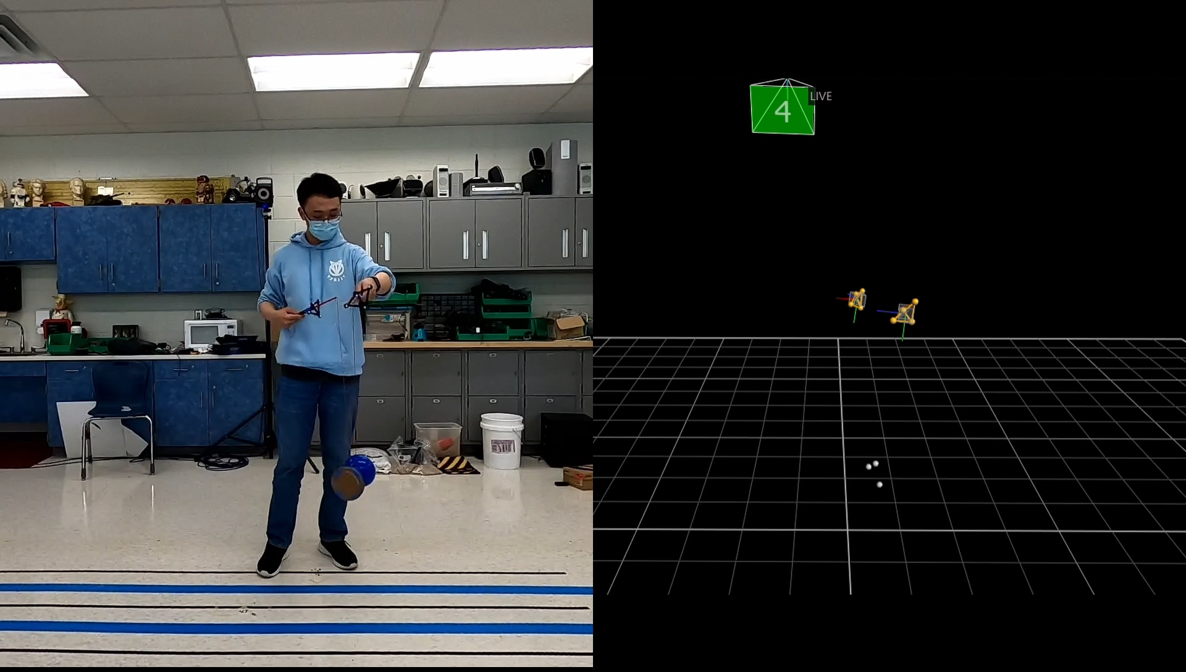

Slide 9
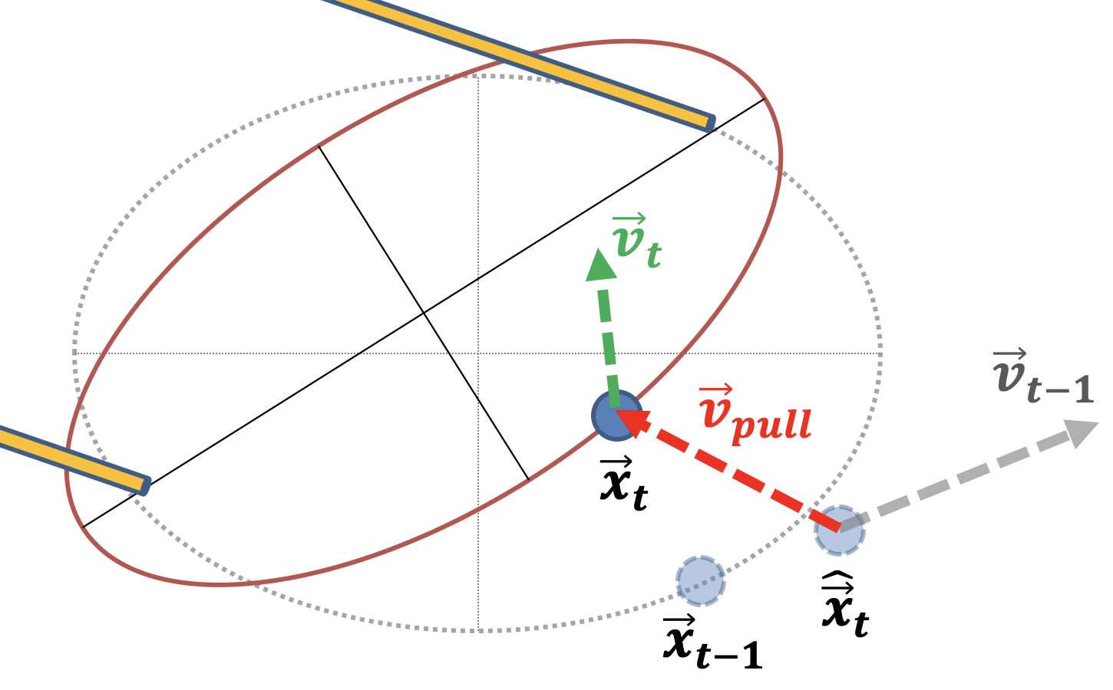
02
Analytical Model
Built on von Drigalski et al.’s model by incorporating pitch prediction
Transpiled researcher’s algorithm into Python
Removed C++ specific library dependencies

Slide 10
02
Pitch Prediction Algorithm
Diabolo Skill Analysis by Rodriguez Ladron de Guevara et al.
Pitch is calculated based on stick’s offset angle and angular velocity

Slide 11
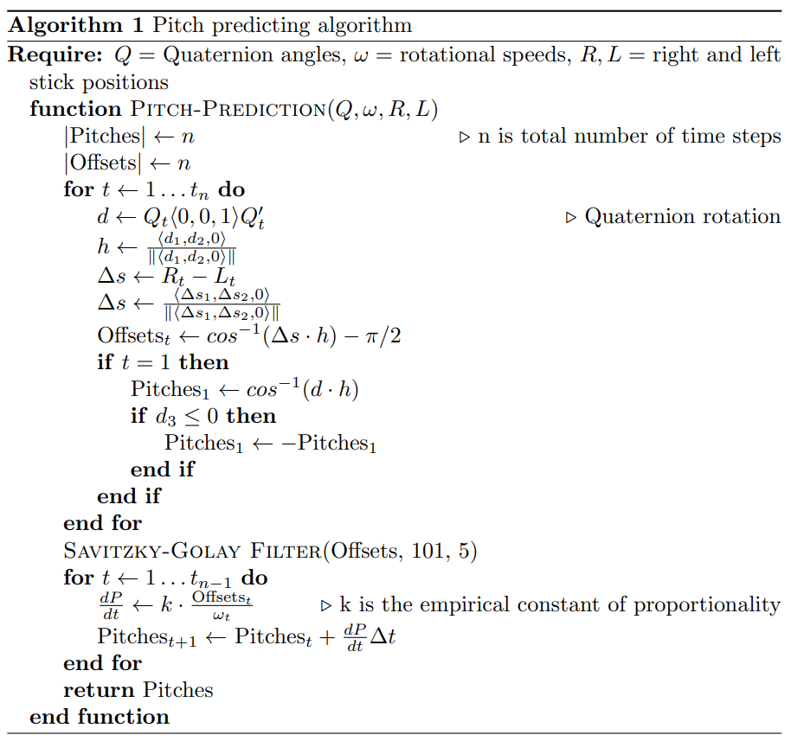
02
Pitch Prediction Algorithm

Slide 12
Pitch Prediction Algorithm
02

Slide 13
Pitch Prediction Algorithm
02

Slide 14
Pitch Prediction Algorithm
02

Slide 15

02
Residual-Physics Learning Neural Network
The analytical model deviates from real life
A Residual-Physics Learning Neural Network (R-PLNN) predicts the differences
von Drigalski et al. vs Zeng et al.
R-PLNN: Keras/Tensorflow and Sequential Model

Slide 16
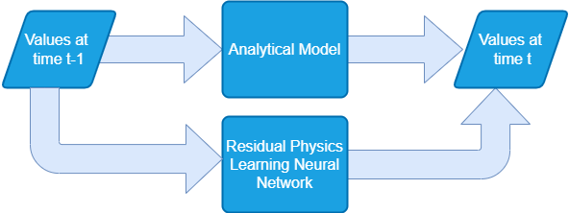

Slide 17
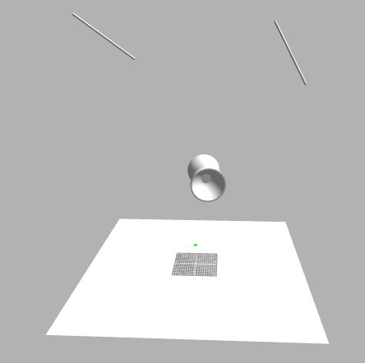
02
Flask - My Site
Flask (Python) backend
JavaScript heavy frontend
The model and Vicon Data streaming
Connecting to Gazebo and displaying data
Notes:
Show video/demo

Slide 18
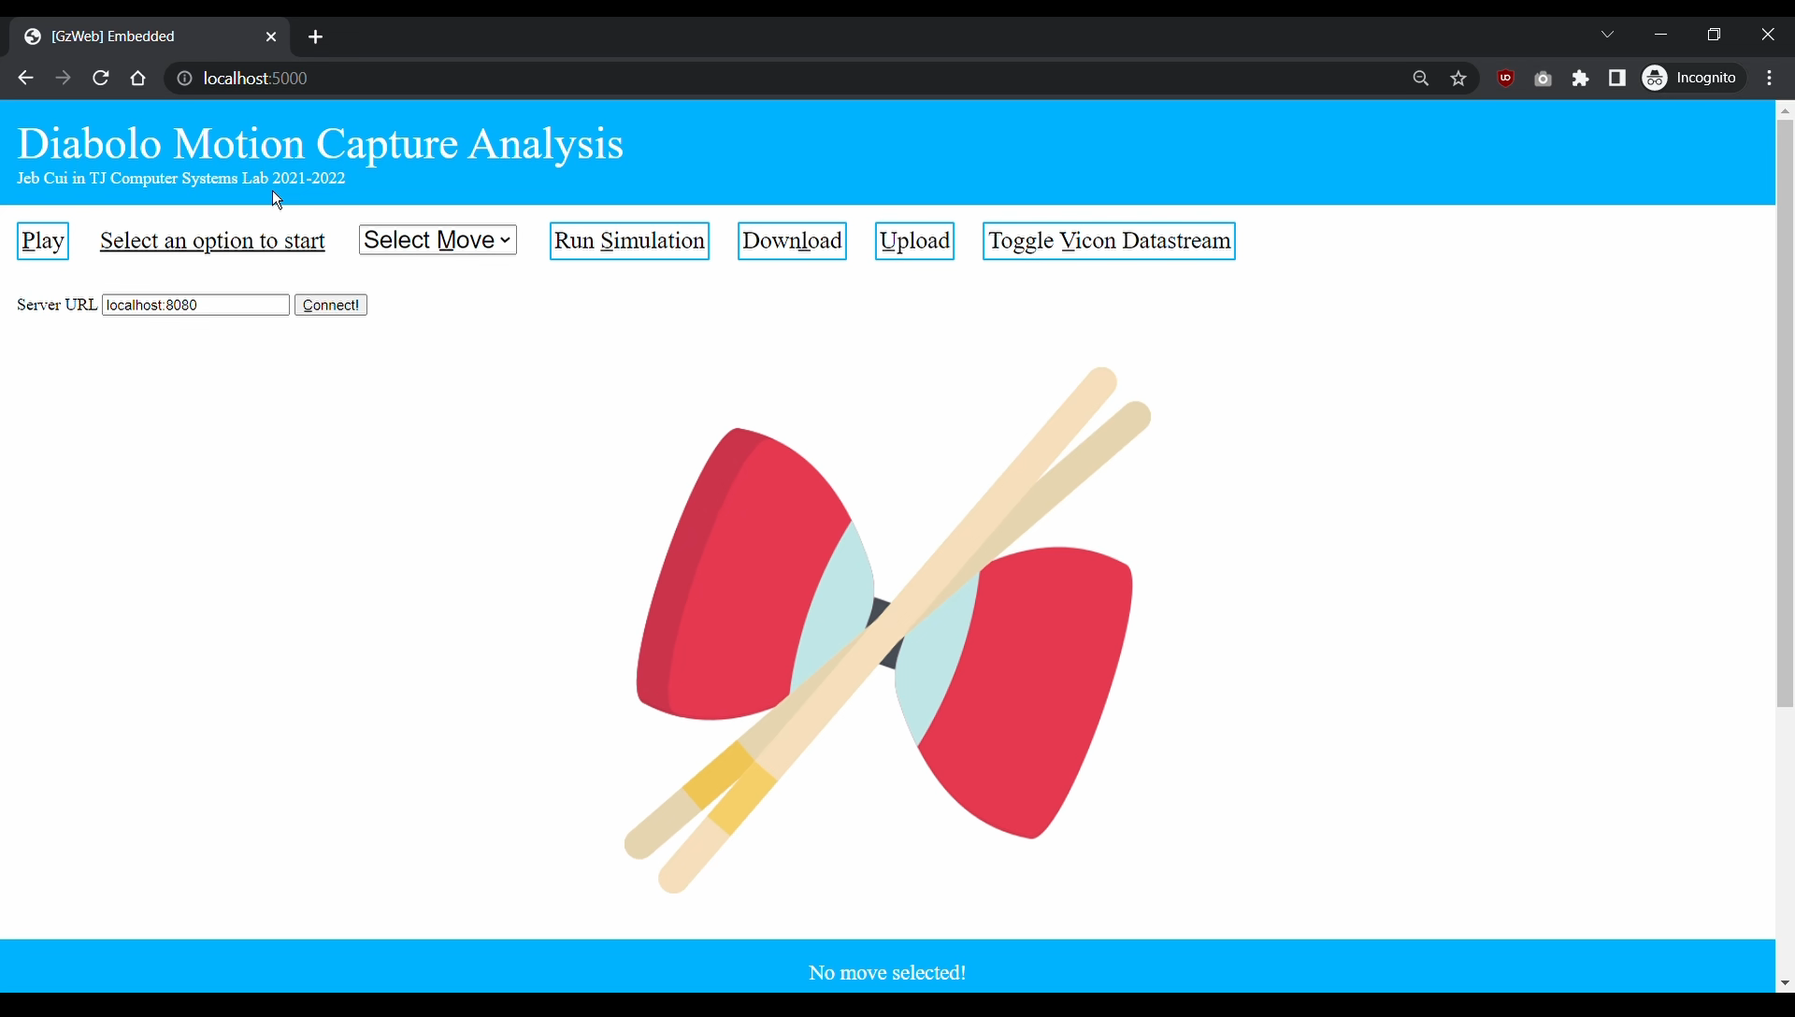

Slide 19
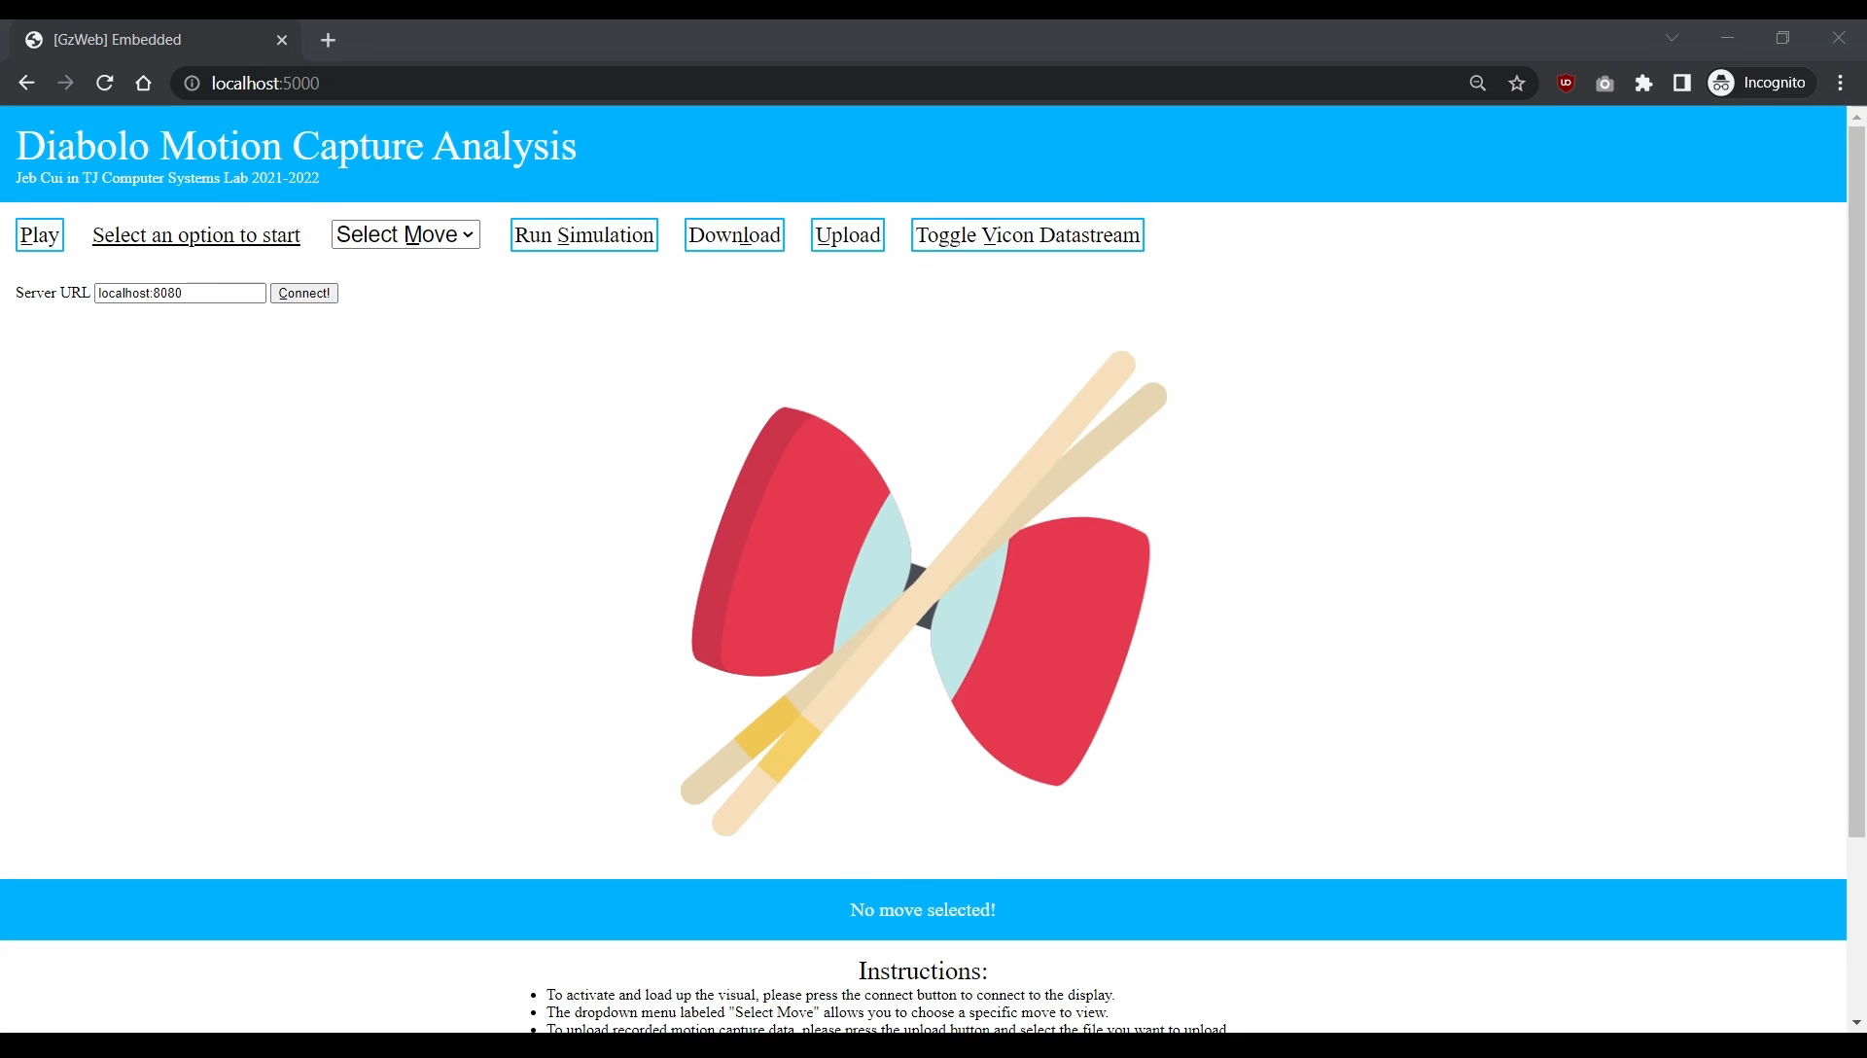

Slide 20
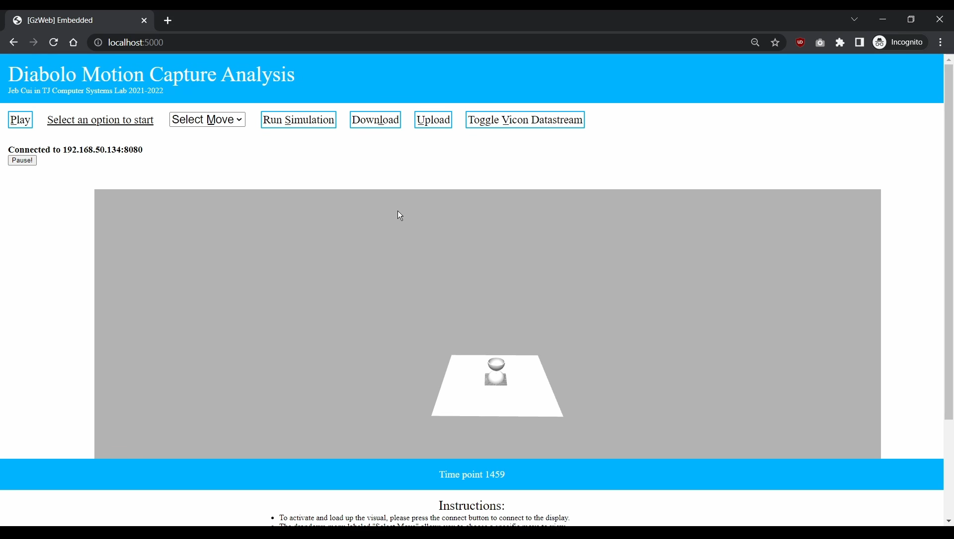

Slide 21
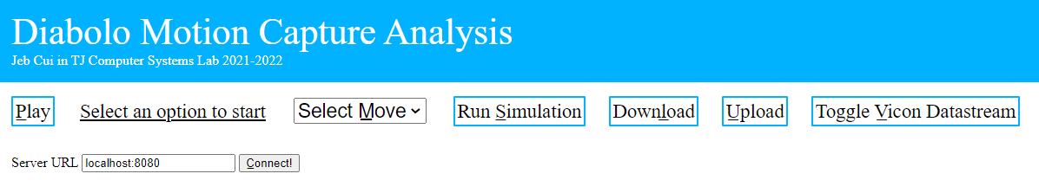
03
Results
Various site functionalities
Improved predictor ability
R-PLNN: MSE of 0.132m² when predicting the differences
Analytical + R-PLNN: MSE of 0.188m² VS Analytical: MSE of 0.771m²

Slide 22
Visit my site at
bit.ly/jebcui-syslab
Notes:
Limited functionality on heroku due to limitations of the hosting service.

Slide 23
Questions?

Slide 24
References
Murooka, T., Okada, K., & Inaba, M. (2020, October 25). Diabolo Orientation Stabilization by Learning Predictive Model for Unstable Unknown-Dynamics Juggling Manipulation. IEEE/RSJ. International Conference on Intelligent Robots and Systems, Las Vegas, NV, USA (Virtual). http://ras.papercept.net/images/temp/IROS/files/3245.pdf
Rodriguez Ladron de Guevara, M., Daly, A., & Bajaj, S. (2018, February 19). Diabolo Skill Analysis – Human-Machine Virtuosity. Cmu.edu. https://courses.ideate.cmu.edu/16-455/s2018/501/diabolo-skill-analysis/
von Drigalski, F., Joshi, D., Murooka, T., Tanaka, K., Hamaya, M., & Ijiri, Y. (2020). An analytical diabolo model for robotic learning and control. ArXiv.org. https://doi.org/10.48550/arXiv.2011.09068
Zeng, A., Song, S., Lee, J., Rodriguez, A., & Funkhouser, T. (2020). TossingBot: Learning to Throw Arbitrary Objects with Residual Physics. ArXiv.org. https://doi.org/10.48550/arXiv.1903.11239

